Slide 1
CSCI 1301 Introduction to Computing and Programming
Summer 2015

Slide 2
Keyboard and Screen I/O

Slide 3
Screen Output
System.out is an object that is part of Java.
println() is one of its methods.
String constants in programs must be written on a single line.
Breaking them across multiple lines causes an error.
The concatenation operator (+) can be used to split strings useful when everything does not fit on one line in the program.
System.out.println("Lucky number = " + 13 + "Secret number = " + number);
Tip: Do not break the line except immediately before or after the concatenation operator (+).

Slide 4
nextLine()Method Caution
The nextLine() method reads the remainder of the current line, even if it is empty.
Given input
n is set to 1301, but s1 is set to the empty string.
int n;
String s1, s2;
n = keyboard.nextInt();
s1 = keyboard.nextLine();
s2 = keyboard.nextLine();
1301
Is teaching me
To be a wizard

Slide 5
import java.util.Scanner;
public class ScannerDemo
{ public static void main(String[] args)
{
Scanner scannerObject = new Scanner(System.in);
System.out.println("Enter two ints separated by spaces:");
int n1, n2;
n1 = scannerObject.nextInt( );
n2 = scannerObject.nextInt( );
System.out.println("You entered " + n1 + " and " + n2);
System.out.println("Next enter two doubles.");
double d1, d2;
d1 = scannerObject.nextDouble( );
d2 = scannerObject.nextDouble( );
System.out.println("You entered " + d1 + " and " + d2);
System.out.println("Next enter two words:");
String s1, s2;
s1 = scannerObject.next( );
s2 = scannerObject.next( );
System.out.println("You entered \"" +s1 + "\" and \"" + s2 + "\"");
s1 = scannerObject.nextLine( ); //To get rid of '\n'
System.out.println("Next enter a line of text:");
s1 = scannerObject.nextLine( );
System.out.println("You entered: \"" + s1 + "\"");
}
}

Slide 6
Flow of Control: Branching
Chapter 3

Slide 7
Flow of Control
Flow of control: the order in which statements are executed.
Up to now, the order has been sequential.
The program forms a line.
A branching statement chooses between possible actions.
The program forms a tree (with multiple branches).
A loop statement repeats a sequence of steps.
The steps are repeated until a stopping condition occurs,
at which point, the program “breaks out of the loop”.

Slide 8
The type boolean and Boolean Expressions
boolean is a primitive type with two values: true and false.
A Boolean expression evaluates to either true or false.
false
2 > 1
2 >= 1 //greater than or equal to
1 != 2 //not equal to
numDogs > numCats
balance <= 0
A boolean variable can be given the value of a Boolean expression by using an assignment operator.
boolean isPositive = (number > 0);

Slide 9
Naming Boolean Variables
It’s good style to use names that suggest having a truth value.
isPositive or systemsAreOk

Slide 10
Input and Output of Boolean Values
Scanner input = new Scanner(System.in);
boolean booleanVar = false;
System.out.println(booleanVar);
System.out.println("Enter a boolean value:");
booleanVar = input.nextBoolean();
System.out.println("You entered " + booleanVar);

Slide 11
Input and Output of Boolean Values
Scanner input = new Scanner(System.in);
boolean booleanVar = false;
System.out.println(booleanVar);
System.out.println("Enter a boolean value:");
booleanVar = input.nextBoolean();
System.out.println("You entered " + booleanVar);
false
Enter a boolean value:
true
You entered true

Slide 12
The if-else Statement
Boolean expressions are used in branching statements.
A branching statement chooses between possible actions.
The primary type is an if-else statement.
if (BooleanExpression)
{
// Statement_1
}
else
{
// Statement_2
}
A compound statement (or block)is enclosed in { … }.
It is treated as a unit (a big statement).
Indention is used for the sake of readability.

Slide 13
The if-else Statement
if (BooleanExpression)
{
// Statement Block 1
}
else
{
// Statement Block 2
}
The Boolean expression is first evaluated.
If it evaluates to true, then the block 1 statements are executed.
If it evaluates to false, then the block 2 statements are executed.
Is it possible to execute Block 1 and Block 2?

Slide 14
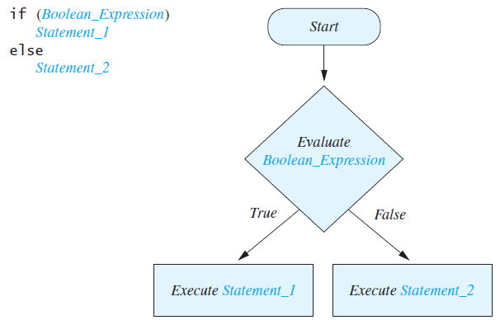
Branching statements cause the flow of control to split into two or more possible lines of execution.

Slide 15
import java.util.Scanner;
public class BankBalance
{
public static final double OVERDRAWN_PENALTY = 8.00; //8 dollars
public static final double INTEREST_RATE = 0.02;//2% annually
public static void main(String[] args)
{
double balance;
System.out.print("Enter your checking account balance: $");
Scanner keyboard = new Scanner(System.in);
balance = keyboard.nextDouble( );
System.out.println("Original balance $" + balance);
//Fill in this part of the code. If the balance is negative, they are penalized. Otherwise, they receive the interest.
System.out.println("After adjusting for one month");
System.out.println("of interest and penalties,");
System.out.println("your new balance is $" + balance);
}
}

Slide 16
import java.util.Scanner;
public class BankBalance
{
public static final double OVERDRAWN_PENALTY = 8.00; //8 dollars
public static final double INTEREST_RATE = 0.02;//2% annually
public static void main(String[] args)
{
double balance;
System.out.print("Enter your checking account balance: $");
Scanner keyboard = new Scanner(System.in);
balance = keyboard.nextDouble( );
System.out.println("Original balance $" + balance);
if (balance >= 0)
balance = balance + (INTEREST_RATE * balance)/12;
else
balance = balance - OVERDRAWN_PENALTY;
System.out.println("After adjusting for one month");
System.out.println("of interest and penalties,");
System.out.println("your new balance is $" + balance);
}
}

Slide 17
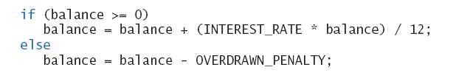
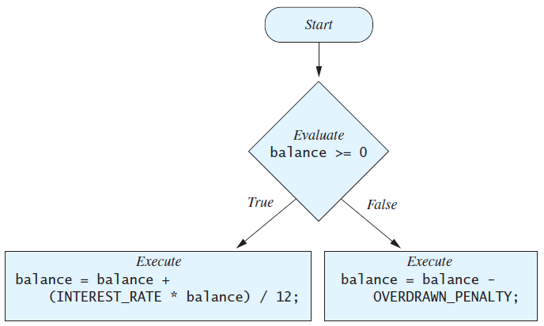

Slide 18
Example Output
Enter your checking account balance: $400.09
Original balance $400.09
After adjusting for one month
of interest and penalties,
your new balance is $400.7568166666666
Enter your checking account balance: $-1000000.09
Original balance $-1000000.09
After adjusting for one month
of interest and penalties,
your new balance is $-1000008.09

Slide 19
Shorthand
If the block to be executed contains only a single statement, the braces are optional. Be careful using this!
means the same as
if (balance >= 0)
{
balance = balance + (INTEREST_RATE * balance)/12;
}
else
{
balance = balance - OVERDRAWN_PENALTY;
}
if (balance >= 0) balance = balance + (INTEREST_RATE * balance)/12;
else balance = balance - OVERDRAWN_PENALTY;

Slide 20
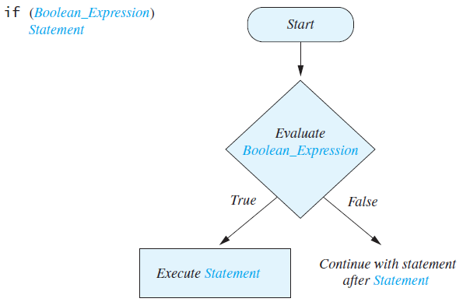
Omitting the else Part
The else part is also optional.
if (balance >= 0) balance = balance + (INTEREST_RATE * balance)/12;
System.out.println(“Your balance is $” + balance);
If the boolean expression is false, what is output?

Slide 21
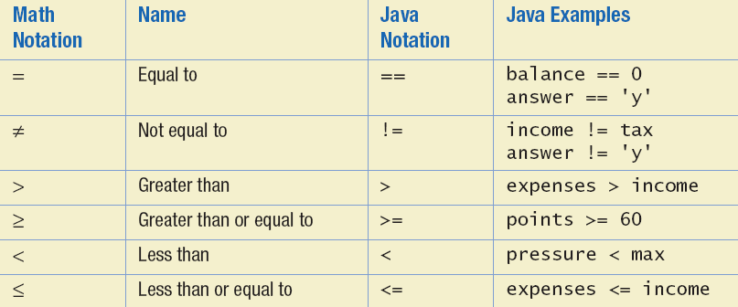
Java Comparison Operators
A Boolean expression evaluates to either true or false.
There are many operators for comparing primitive data type values.
They all evaluate to either true or false.

Slide 22
Enumerations
Often, values for a variable should only come from a fixed set of possible values.
An enumeration allows one to specify this.
Like named constants, enum declarations appear inside the class body but outside of any method definitions (outside of main).
Once defined, variables can be declared using the enumeration’s name as data type.
enum MovieRating {G, PG, PG13, R, NC17}
MovieRating jaws = MovieRating.PG;

Slide 23
Nested if-else Statements
An if-else statement can contain other statements.
It can also contain another if-else statement.
That is, they can be nested.
An if-else may be nested within the "if" part.
An if-else may be nested within the "else" part.
An if-else may be nested within both parts.

Slide 24
Nested Statements
if (Boolean_Expression_1)
if (Boolean_Expression_2)
//Statement_1
else
//Statement_2
else
if (Boolean_Expression_3)
//Statement_3
else
//Statement_4

Slide 25
Nested Statements
Consider:
Same thing? Without braces, the else goes with the closest unpaired if.
First Form
if (a > b) { if (c > d) e = f } else g = h;
Second Form
if (a > b) if (c > d) e = f else g = h;

Slide 26
Nested Statements
Each else is paired with the nearest unmatched if.
Braces can be used like parentheses to group statements.
Indentation should be used to indicate which if goes with which else.
Remember: Indentation doesn’t affect the actual pairings.
It’s only for the sake of the reader.
The compiler will ignore the white space.
Look at Grader Program 2

Slide 27
Announcements
Lab assignment 4 due February 6th by 9pm.
Not accepted after Sunday at 9pm
Project 2 now posted – due February 13th by 9pm
See website for jar file usage
Readings for this week: Ch 3.
Review (Feb 10th), Test 1 (Feb 12th)
ACM Meeting

Slide 28
Multibranch if-else Statements
If-else statements can also be chained together.
This is used if there are more than two cases.
Default_Statement is executed if no if statement is matched.
if (Boolean_Expression_1)
Statement_1
else if (Boolean_Expression_2)
Statement_2
else if (Boolean_Expression_3)
Statement_3
else if …
else
Default_Statement
How many statements can execute
In this example?

Slide 29
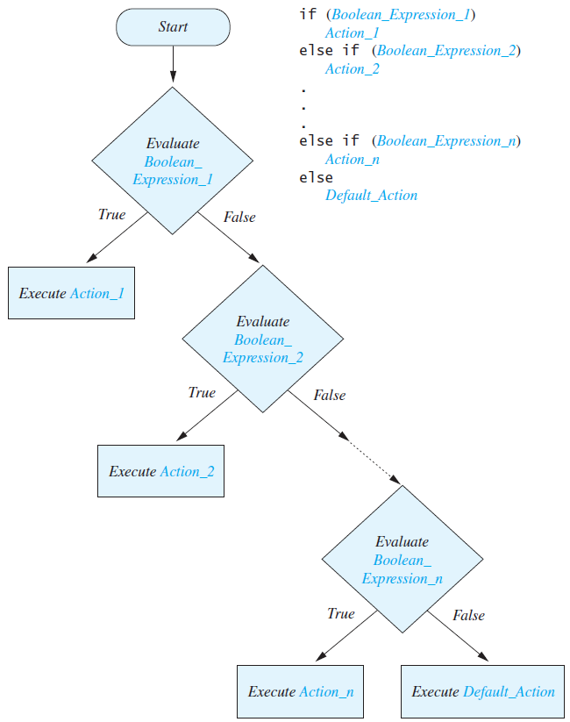
A multi-branch statement splits a program into multiple branches.
Program execution will follow one branch.
Note: This is really just a programmer convenience.
We could get by with nested if-else statements.
Grader 1

Slide 30
import java.util.Scanner;
public class Grader
{
public static void main(String[] args) {
int score;
char grade;
System.out.println("Enter your score: ");
Scanner keyboard = new Scanner(System.in);
score = keyboard.nextInt( );
if (score >= 90)
grade = 'A';
else if (score >= 80)
grade = 'B';
else if (score >= 70)
grade = 'C';
else if (score >= 60)
grade = 'D';
else
grade = 'F';
System.out.println("Score = " + score);
System.out.println("Grade = " + grade);
}
}

Slide 31
Multibranch if-else Statements
Using a nested if-else statement is not as easy to read.

Slide 32
//Assume variables are initialized exactly as in the last example
if (score >= 90)
grade = 'A’;
else
{
if (score >= 80)
grade = 'B';
else
{
if (score >= 70){
grade = 'C';
else
{
if (score >= 60)
grade = 'D';
else
grade = 'F';
}
}
}
System.out.println("Score = " + score);
System.out.println("Grade = " + grade);

Slide 33
Multibranch if-else Statements
What if we change all of the else if lines to be just if statements?
Does the code still work?

Slide 34
import java.util.Scanner;
public class Grader
{
public static void main(String[] args) {
int score;
char grade;
System.out.println("Enter your score: ");
Scanner keyboard = new Scanner(System.in);
score = keyboard.nextInt( );
//does this also work?
if (score >= 90)
grade = 'A';
if (score >= 80)
grade = 'B';
if (score >= 70)
grade = 'C';
if (score >= 60)
grade = 'D';
else
grade = 'F';
System.out.println("Score = " + score);
System.out.println("Grade = " + grade);
}
}

Slide 35
Multibranch if-else Statements
What if we change all of the else if lines to be just if statements?
Does the code still work?
No
Is there a way to make it work?

Slide 36
import java.util.Scanner;
public class Grader
{
public static void main(String[] args) {
int score;
char grade;
System.out.println("Enter your score: ");
Scanner keyboard = new Scanner(System.in);
score = keyboard.nextInt( );
//Why is this not necessary?
if (score >= 90)
grade = 'A';
else if ((score >= 80) && (score < 90))
grade = 'B';
else if ((score >= 70) && (score < 80))
grade = 'C';
else if ((score >= 60) && (score < 70))
grade = 'D';
else
grade = 'F';
System.out.println("Score = " + score);
System.out.println("Grade = " + grade);
}
}
Does this code work?

Slide 37
Compound Boolean Expressions
There are operators for AND, OR, and NOT.
AND: && Exp1 && Exp2
OR: || Exp1 || Exp2
NOT: ! !Exp
(Exp1 and Exp2 are Boolean expressions.)
These are used to form compound expressions.
(score > 0) && (score <= 100)
(grade < 0) || (grade > 100)
!(score < 60)
Note: 100 > score > 0 is NOT valid in Java.

Slide 38
AND: &&
(Sub_Expression_1) && (Sub_Expression_2)
The larger expression evaluates to true only if both of the smaller expressions evaluate to true.
It evaluates to false otherwise.
Parentheses are used to enhance readability.

Slide 39
OR: ||
(Sub_Expression_1) || (Sub_Expression_2)
The larger expression evaluates to true if either one or both of the smaller expressions evaluate to true.
|| is called “inclusive-or”.
The expression is true if both smaller expressions are true.
There is also an “exclusive-or” (^). How is it different?
It is true if exactly one of the smaller expressions is true.
(Sub_Expression_1) ^ (Sub_Expression_2)

Slide 40
NOT: !
A boolean expression can be negated using the "not" (!).
!(Boolean_Expression)
It simply “flips” the truth value of Boolean_Expression
If a is true, then !a is false.
Examples:
!(percent < 0 && percent > 100)
!(a && b) // the same as (!a || !b)
!(a || b) // the same as (!a && !b)
(a || b) && !(a && b) // the same as exclusive or

Slide 41
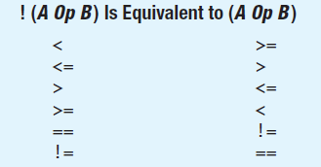
Negating a Boolean Expression
Programs are easier to read if they don’t contain negations.
“Can you not not understand this?”
So, consider using equivalent expressions without negations.

Slide 42
Boolean Operators: Summary
A | B | A && B | A || B | A ^ B | !A
true | true
true | false
false | true
false | false

Slide 43
Boolean Operators: Summary
A | B | A && B | A || B | A ^ B | !A
true | true | true
true | false | false
false | true | false
false | false | false

Slide 44
Boolean Operators: Summary
A | B | A && B | A || B | A ^ B | !A
true | true | true | true
true | false | false | true
false | true | false | true
false | false | false | false

Slide 45
Boolean Operators: Summary
A | B | A && B | A || B | A ^ B | !A
true | true | true | true | false
true | false | false | true | true
false | true | false | true | true
false | false | false | false | false

Slide 46
Boolean Operators: Summary
A | B | A && B | A || B | A ^ B | !A
true | true | true | true | false | false
true | false | false | true | true | false
false | true | false | true | true | true
false | false | false | false | false | true

Slide 47
Short-circuit Evaluation
Sometimes only part of a boolean expression needs to be evaluated to determine the value of the whole thing.
If a is true, then (a || b) is true.
If a is false, then (a && b) is false.
In these cases, the program won’t evaluate b.
This is called short-circuit or lazy evaluation.

Slide 48
Short-circuit Evaluation
Short-circuit evaluation is sometimes essential.
E.g., to avoid a run-time error.
if (sum/number > 5) //possible runtime error?
Correction:
if ((number != 0) && (sum/number > 5))
Above, if number is 0, then short-circuit evaluation avoids a division by zero error.
Complete evaluation can be achieved by substituting & for && or | for ||.

Slide 49
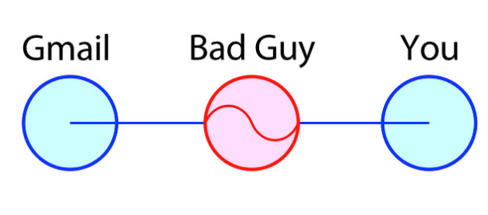
Side Note: Apple’s Recent Security Flaw
Made Man in the Middle Attacks Easy:
http://gizmodo.com/why-apples-huge-security-flaw-is-so-scary-1529041062

Slide 50
How MitM Attacks are Avoided
Typically, there is communication between your browser and Gmail to ensure that you are, in fact, talking with Gmail (and not a hacker).
The flaw in Apple’s OS basically did not do a thorough check and a hacker could pretend to be Gmail, facebook, banking websites, etc.
This let them read information that you were sending between your browser and the gmail, etc. server.
Only affected shared public networks. Also, small chance that someone was trying to steal your data.
But still scary!
How did this happen?!?

Slide 51
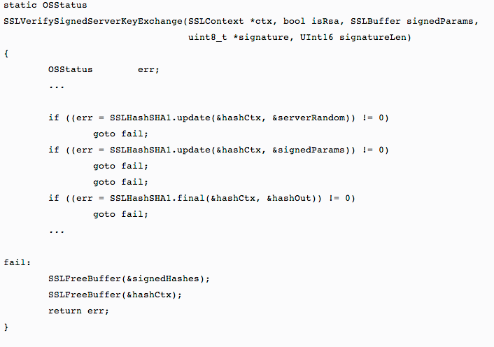
Here’s the Broken Code

Slide 52
Using Equality: ==
== is appropriate for determining if two integers or characters have the same value.
if (a == 3)
where a is an integer type
== is not appropriate for use with floating point values.
Why not?

Slide 53
Using Equality: ==
== is not appropriate for use with floating point values.
Why not?
Because floating point values are approximations.
It’s better to specify some value such that if a and b differ by less than that, then they are considered equal.
if (abs(a - b) < epsilon)
where a, b, and epsilon are floating point types

Slide 54
Using Equality: ==
== should not be used to compare objects.
Suppose s1 and s2 refer to string objects.
(s1 == s2), is true if and only if s1 and s2 refer to the same memory location.
If s1 and s2 refer to strings with identical sequences of characters, but stored in different memory locations, (s1 == s2) is false.

Slide 55
So, what’s the output?
String s1 = "hello";
String s2 = "hello";
String s3 = s1 + "1";
String s4 = s2 + "1";
System.out.println(s1 == s2);
System.out.println(s3 == s4);

Slide 56
String s1 = "hello";
String s2 = "hello";
String s3 = s1 + "1";
String s4 = s2 + "1";
System.out.println(s1 == s2);
System.out.println(s3 == s4);
When a string literal ("hello") is written, only a single string object is created for it in memory. This is called “interning”.
So s1 and s2 refer to the same thing in memory.
This doesn’t happen when strings are manipulated using “+”.
So s3 and s4 refer to different things in memory.
So, what’s the output?

Slide 57
String s1 = "hello";
String s2 = "hello";
String s3 = s1 + "1";
String s4 = s2 + "1";
System.out.println(s1 == s2);
System.out.println(s3 == s4);
true
false

Slide 58
Using equals not ==
Use method equals to test for equality of objects.
s1.equals(s2) or s2.equals(s1)
For string objects, equals checks to see whether the characters are the same in each string.
equalsIgnoreCase ignores the case of the characters.
("Hello".equalsIgnoreCase("hello"))
The equals method can be defined for each class.
The programmer specifies what counts as equality in classes that you create (more later).

Slide 59
String s1 = "hello";
String s2 = "hello";
String s3 = s1 + "1";
String s4 = s2 + "1";
System.out.println(s1.equals(s2));
System.out.println(s3.equals(s4));

Slide 60
String s1 = "hello";
String s2 = "hello";
String s3 = s1 + "1";
String s4 = s2 + "1";
System.out.println(s1.equals(s2));
System.out.println(s3.equals(s4));
true
true

Slide 61
import java.util.Scanner;
public class StringEqualityDemo
{
public static void main(String[] args) {
String s1, s2;
System.out.println("Enter two lines of text:");
Scanner keyboard = new Scanner(System.in);
s1 = keyboard.nextLine( );
s2 = keyboard.nextLine( );
if (s1.equals(s2))
System.out.println("The two lines are equal.");
else
System.out.println("The two lines are not equal.");
if (s2.equals(s1))
System.out.println("The two lines are equal.");
else
System.out.println("The two lines are not equal.");
if (s1.equalsIgnoreCase(s2))
System.out.println("But the lines are equal, ignoring case.");
else
System.out.println("Lines are not equal, even ignoring case.");
}
}

